Slide 1



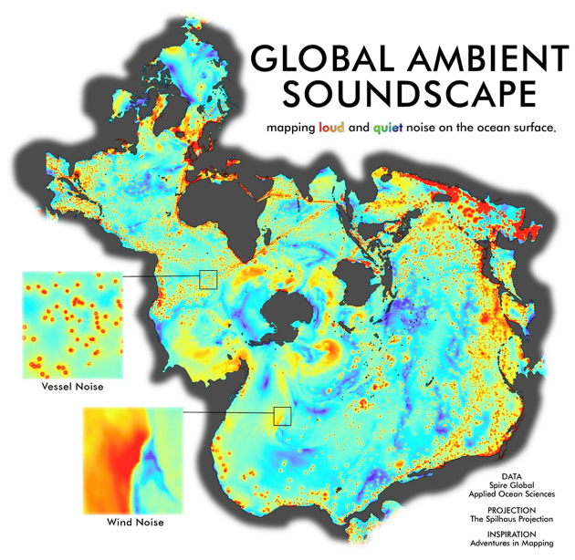
“Ocean Sound as Ocean Science”
Ocean Decade Research Programme on the Maritime Acoustic Environment (UN-MAE)
Modeling and Prediction of Ocean Ambient Sound
A Satellite activity of UN Ocean Decade Laboratories: A Prediction Ocean

Slide 2
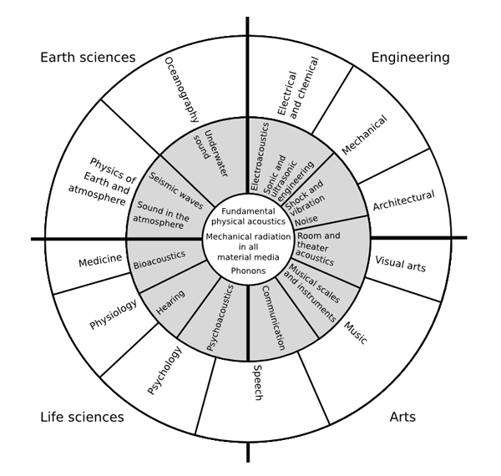
Inspiration
Understand and beat marine pollution
Protect ecosystems and biodiversity
Sustainably feed the global population
Sustainable and equitable global economy
Ocean-based solutions to climate change
Expand the Global Ocean Observing System
Create a digital representation of the ocean
Deliver data, knowledge, and technology to all
Change human relationship with the ocean
Acoustical Oceanography
Animal Bioacoustics
Architectural Acoustics
Biomedical Acoustics
Computational Acoustics
Engineering Acoustics
Musical Acoustics
Noise
Physical Acoustics
Psychological and Physiological Acoustics
Signal Processing in Acoustics
Speech Communication
Structural Acoustics and Vibration
Underwater Acoustics
Lindsay’s Wheel of Acoustics (adapted J. Acoust. Soc. Am. 36:2242(1964)

Slide 3
High-Level Objectives
Sound contains information about source(s) modified by interactions with the environment and objects within the environment.
What in the World Do We Hear? An Ecological Approach to Auditory Event Perception
William W. Gaver (1993) Ecological Psychology, 5:1, 1-29
Acoustic Environment → Listen and Assess → Biological and Physical Environment
(Signal) (Information)
Acoustic Environment ← Model and Predict ← Biological and Physical Environment
(Output) (Inputs)
Objective and quantitative measures in a vastly undersampled environment is a challenge!

Slide 4
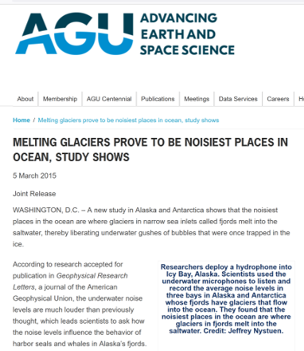
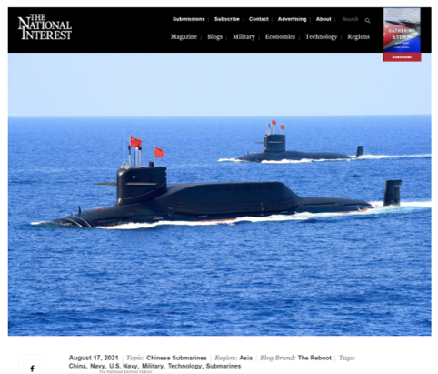

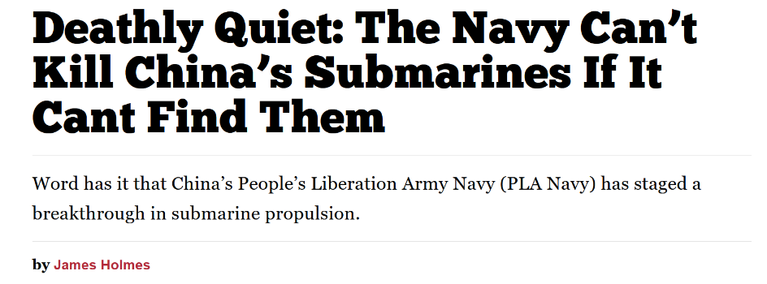
Perspective – Why Sound?
Sound
      Is highly intertwined with both the physical and biological aspects of the ocean that define the field of Oceanography
      Is an interdisciplinary science with economic, environmental, and national security applications

Slide 5



Implementation
Physical
Ocean Decade Research Programme on the Maritime Acoustic Environment (UN-MAE)
Centered on expanding the community of Ocean Scientists and practitioners conversant
in the MAE to address the Decade’s interdisciplinary challenges
Program will comprise discrete projects
Marine Acoustic Environment (MAE)
Anthropogenic
Biological
Challenge
Area(s)
Gaps
Desired Outcomes
Research/
Studies

Slide 6
Proposed Projects
Ocean Decade Research Programme on the Maritime Acoustic Environment (UN-MAE)
Prediction Ocean Laboratory Satellite Activity
Marine Soundscape Modeling Workshop and Validation Studies
Acoustic and Environmental Observation Network (AEON)
Ocean Sound EOV Implementation Plan
National Academies Study on Needs, Training, and Opportunities in Ocean Acoustics
Public Ocean Sound Data Archive
Global Ocean Sound Atlas (Ocean Shot Concept)
Low-Cost Ocean Soundscape Sensing initiatives
Citizen Sound Tourism Workshop
Measuring the Pulse of the Earth’s Global Oceans (Ocean Shot Concept)

Slide 7



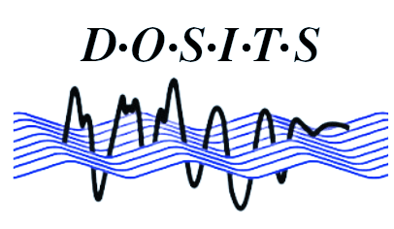


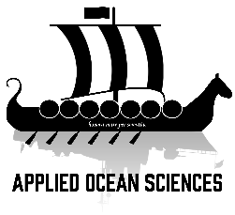


Partners (so far)
“All of You and more!”
Please Join us.

